Slide 1
Quantium Project Presentation
Done by Dyreen Omondi

Slide 2
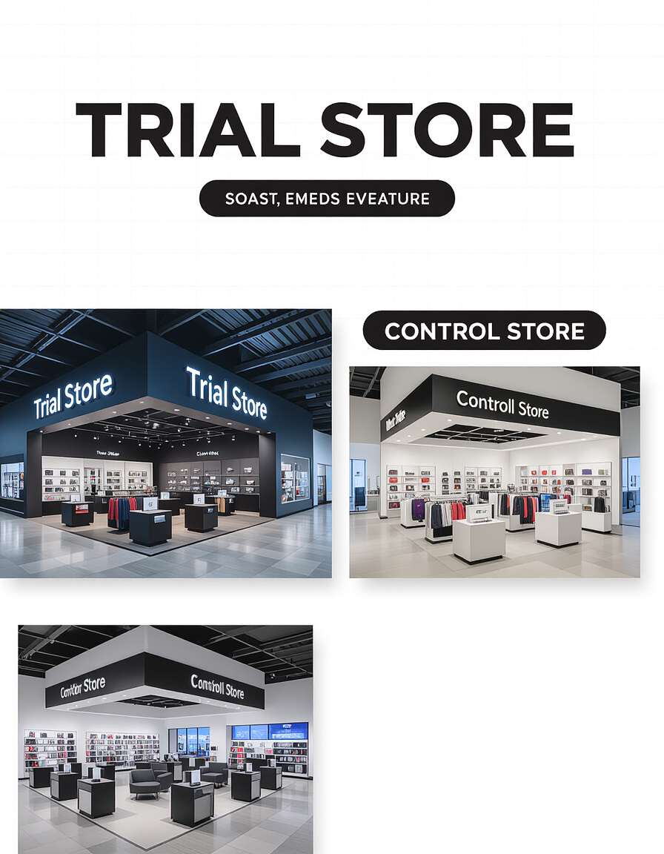
Key Objectives
Evaluate the impact of trial store layouts on sales and customer behavior.
Compare trial stores (77, 86, 88) with their respective control stores.
Provide actionable insights for strategic planning and potential rollout.

Slide 3

Project Overview
Client: Chips Category Manager at Quantium (Ms.
Objective: Determine whether trial store layouts improve sales.
Scope:
  Analysis period: July 2018 – June 2019
  264,834 transactions

Slide 4
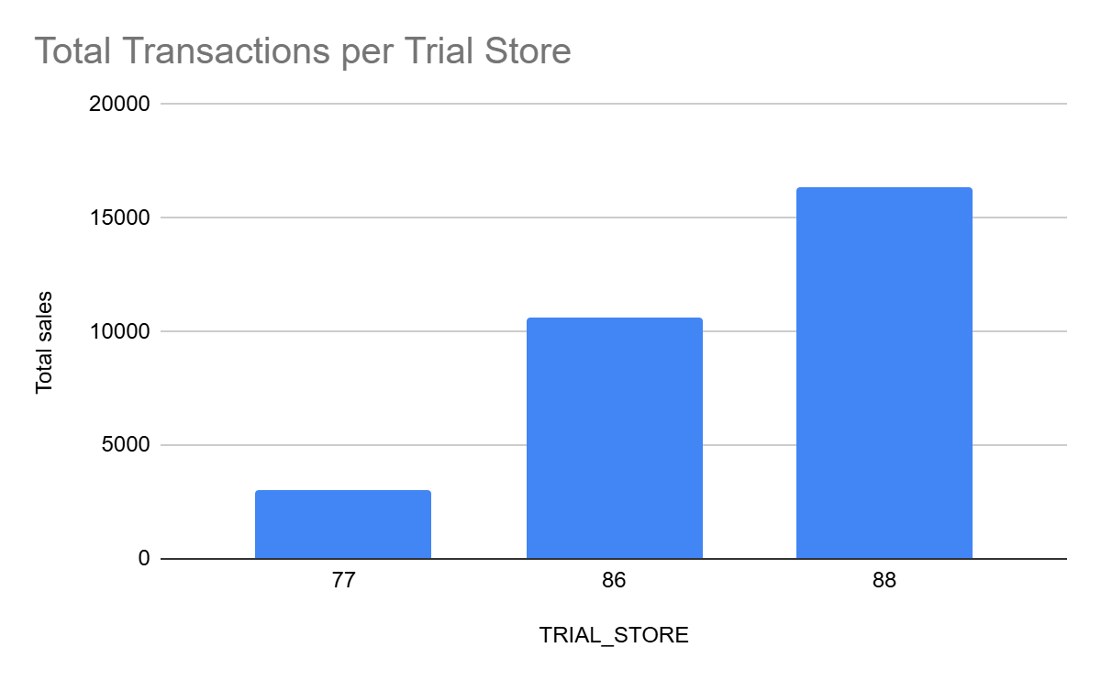
Data Overview
Key dataset columns:
  LYLTY_CARD_NBR
  STORE_NBR
  TXN_ID
  PROD_NAME
  TOT_SALES
Metrics analyzed:
  Total sales
  Unique customers
  Total transactions
  Average transactions per customer

Slide 5
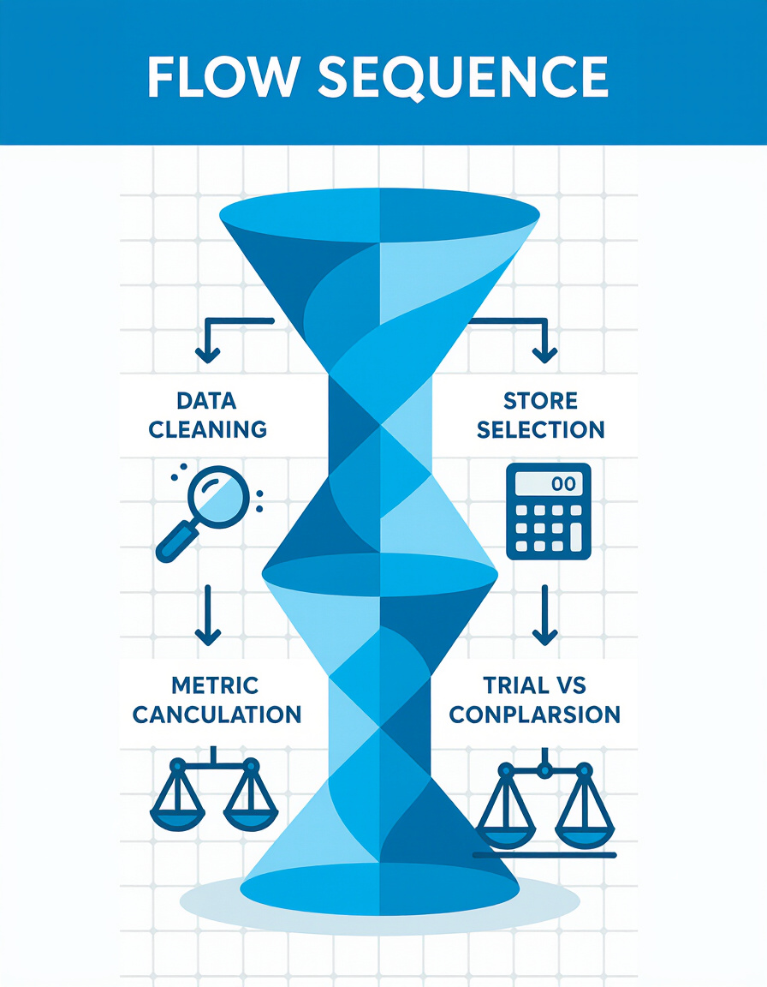
Methodology
Data cleaning and preparation.
Control store selection using sales similarity metrics.
Calculation of key metrics per store.
Comparison of trial stores vs. control averages.

Slide 6

Trial vs Control Store Selection
Trial stores: 77, 86, 88
Control stores:
  77 → 141, 46, 50
  86 → 155, 227, 236
  88 → 165, 40, 237

Slide 7
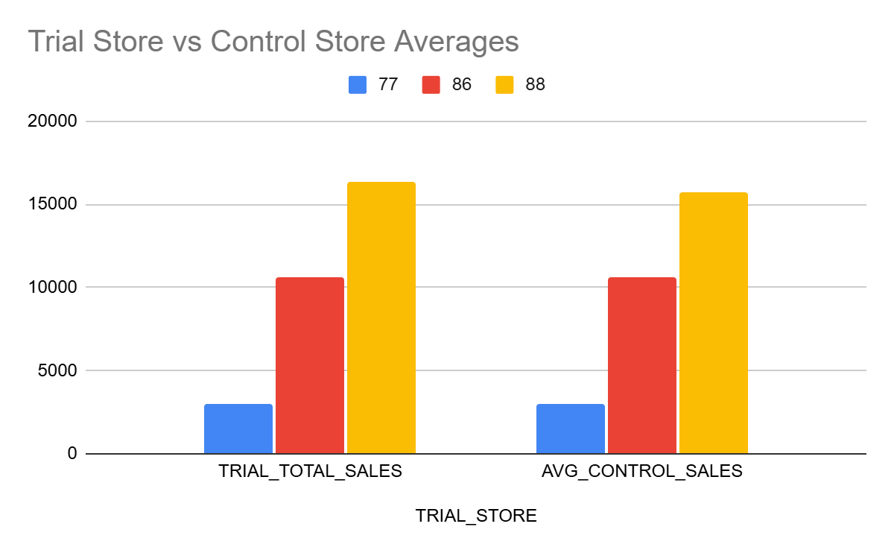
Trial Store 77 Analysis
Total Sales: $3040
Avg Control Sales: $3019.55
Sales Uplift: 0.68%
Avg Transactions per Customer: 1.58

Slide 8
Trial Store 86 Analysis
$10,635.35
$10,624.15
Total Sales
Avg Control Sales
0.11%
5.59
Sales Uplift
Avg Transactions per Customer

Slide 9
Trial Store 88 Analysis
$16,333.25
$15,690.92
Total Sales
Avg Control Sales
4.09%
4.79
Sales Uplift
Avg Transactions per Customer

Slide 10
Trial vs Control Summary
TRIAL_STORE | TRIAL_TOTAL_SALES | AVG_CONTROL_SALES | SALES_UPLIFT_PERCENT | AVG_TXNS_PER_CUSTOMER
77 | 3040 | 3019.55 | 0.68% | 1.58
86 | 10635.35 | 10624.15 | 0.11% | 5.59
88 | 16333.25 | 15690.92 | 4.09% | 4.79
Notes:
- Table:
- **Store 88** showed the best performance.

Slide 11
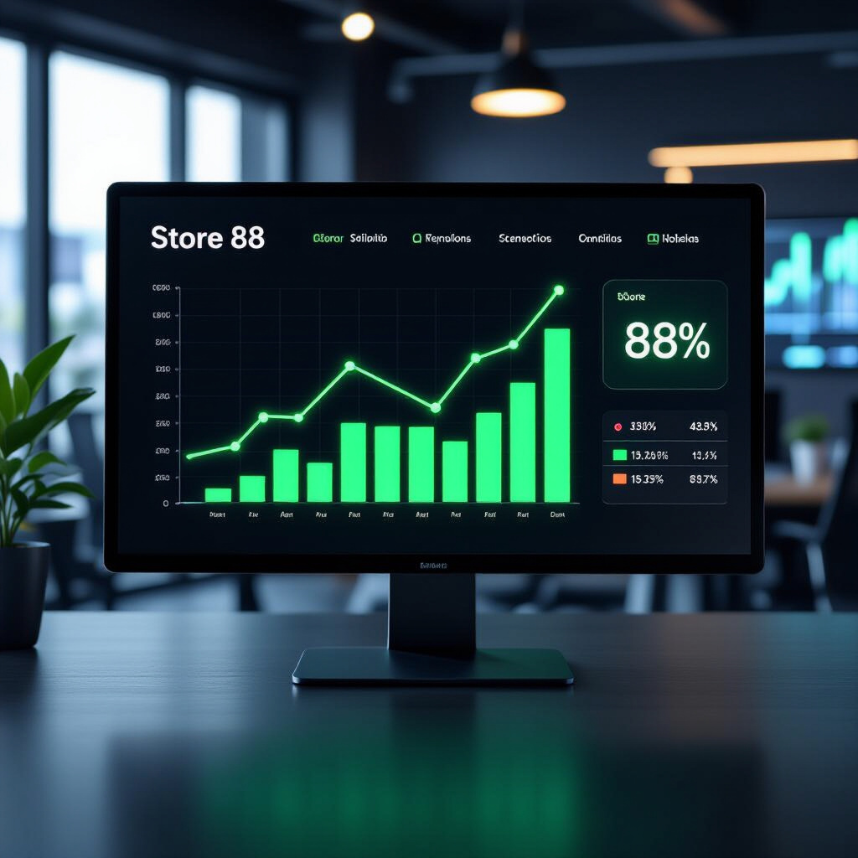
Key Insights
Trial stores generally performed better than controls.
Sales uplift driven primarily by more transactions per customer.
Store 88 had the highest uplift (4.09%).

Slide 12

Recommendations
Roll out successful trial layouts to selected stores.
Continue monitoring customer behavior and sales metrics.
Consider further testing in underperforming stores.

Slide 13

Next Steps
Track performance of rolled-out layouts over the next quarter.
Conduct deeper analysis by product categories or customer segments.
Update strategic plan using trial insights.

Slide 14
Conclusion
Trial layouts positively impacted sales and customer engagement.
Insights provide clear guidance for strategic rollout.
Continued monitoring recommended for sustained performance.

